Slide 1



Innovative Pathways Toward a Balanced Future
Sustainable resource systems represent
John Doe

Slide 2
Building the bridge between awareness and action

Slide 3
Table of Content
1
Introduction: The Need for Sustainable Resource Systems
5
Environmental and Economic
Impacts
2
Understanding Biomass Biorefinery
Networks
6
Network Optimization and
Modeling
3
Feedstock Diversity and Resource
Flows
7
Policy, Market, and Industry
Perspectives
4
Technological Innovations
in Biorefinery Design
8
Future Outlook and Research
Directions

Slide 4

Proceed through the slides in order to understand how sustainable resource systems are developed, implemented, and evaluated.
Pay attention to data trends and relationships shown in charts and tables. They provide valuable insights into resource consumption, investment priorities, and sustainability outcomes.
5 mins

Slide 5
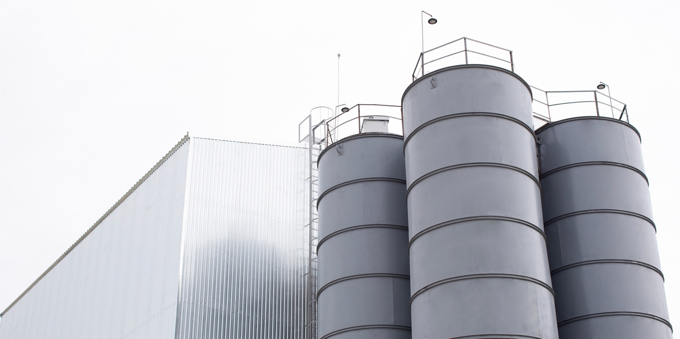
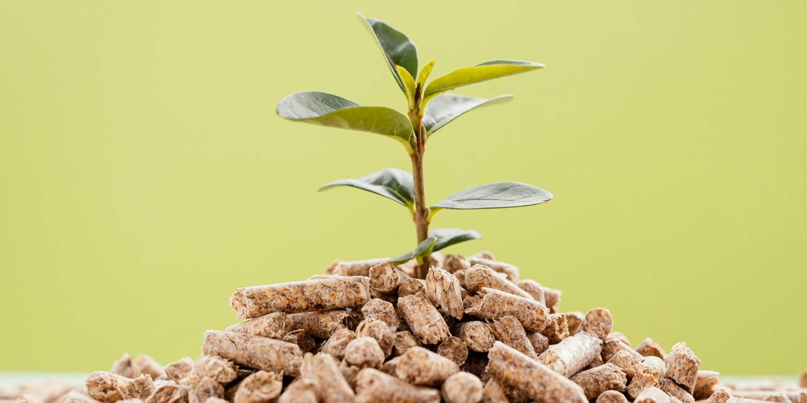
Developing sustainable resource systems involves adopting innovative approaches
Sustainable resource systems
Sustainable practices
By implementing sustainable practices, we can promote the conservation of natural habitats, reduce greenhouse gas emissions, and foster resilience within communities and industries.
The need for sustainable resource systems has become increasingly urgent in light of the rapid depletion of finite natural resources, environmental degradation, and the growing impacts of climate change.

Slide 6
The need for sustainable resource systems has become increasingly urgent
From Extraction to Regeneration
The increasing global demand for energy, materials, and food has placed immense pressure on natural resources and ecosystems. Traditional linear production models — based on extraction, consumption, and disposal — are no longer viable in the face of climate change and resource scarcity.
Sustainable resource systems aim to close material loops, reduce waste, and promote renewable inputs across industries. Biomass plays a central role in this transition, offering a renewable and versatile source for energy and bio-based products.
XX%
reduce
waste
XX%
promote inputs

Slide 7
Five Steps to Harnessing Biomass Biorefinery Networks
01
03
05
Understanding Biomass
Optimizing
Biomass
Future
Outlook
Exploring the types and sources
of biomass for sustainable use
Implementing strategies to maximize output
Shaping regulations and advancing technologies
02
04
Designing Biomass
Promoting
Biomass
Creating efficient systems for biomass conversion
Fostering partnerships for sustainable resource cycles

Slide 8





Timeline of Biomass Biorefinery Networks in Sustainable Resource Management
Early
Foundations
Development
and Expansion
Mainstream Adoption
Future Innovations
Initial research, pilot projects, and emerging interest in biomass utilization
Scaling up biorefinery technologies and establishing collaborative networks
Wider implementation, policy incentives, and integration into sustainable practices
Advancing technologies, international cooperation, and long-term sustainability goals
Initial research, pilot projects, and emerging interest in biomass utilization
Scaling up biorefinery technologies and establishing collaborative networks
Wider implementation, policy incentives, and integration into sustainable practices
Advancing technologies, international cooperation, and long-term sustainability goals
2020 and Before
2021-2023
2024-2026
Beyond 2026

Slide 9

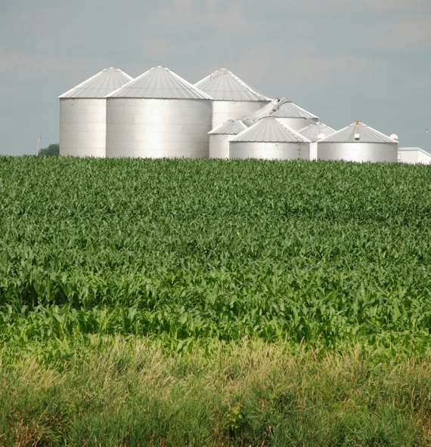
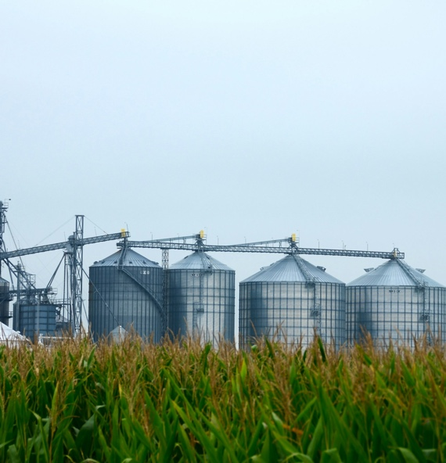
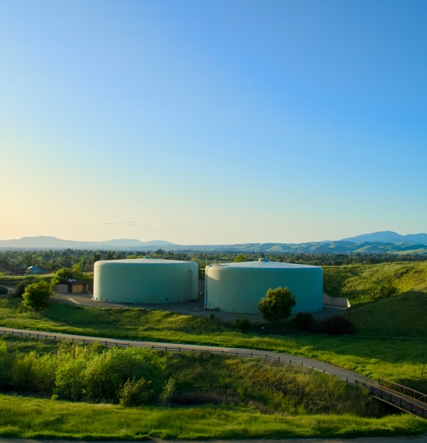
Concept of Biomass Biorefinery Networks. Systems for biomass conversion and utilization
Understanding Biomass Networks
Key Components of Biomass Systems
Integration and Optimization
Future Directions and Challenges
Exploring the Principles, Goals, and Impact of Integrated Biomass
Innovative Research, Policy Frameworks, and the Path Towards a Circular Bioeconomy
Strategies for Integration, Scalability, and Resource Efficiency in Biorefinery Networks
Advances in Chemical, Biological, and Mechanical Processes for Value-Added Products

Slide 10
Sustainable resource systems rely on measurable progress
This chart highlights the steady rise in global resource consumption
This visualization shows how funding for sustainable development is currently distributed across sectors.
This chart compares the relative environmental, economic, and social benefits

Slide 11
Global Resource Consumption
Tracking the widening gap between human demand and the planet’s ability to renew resources
This chart illustrates the growing imbalance between global resource consumption and Earth’s natural regenerative capacity over time. While population growth and industrial expansion have driven resource use to unprecedented levels, the planet’s renewal rate has remained relatively constant.

Slide 12
Innovative Pathways Toward a Balanced and Resilient Future.
Your Text | Your Text | Your Text | Your Text | Your Text
Your Text | Your Text | Your Text | Your Text | Your Text
Your Text | Your Text | Your Text | Your Text | Your Text
Your Text | Your Text | Your Text | Your Text | Your Text
Your Text | Your Text | Your Text | Your Text | Your Text
Your Text | Your Text | Your Text | Your Text | Your Text
Your Text | Your Text | Your Text | Your Text | Your Text
Your Text | Your Text | Your Text | Your Text | Your Text

Slide 13

Process of Developing Sustainable Resource Systems
Identifying resource challenges
Integrating innovative solutions into existing systems
Tracking progress and refining strategies
The process begins with evaluating current resource use, environmental impact, and economic dependencies. Through data analysis and stakeholder engagement, organizations define clear sustainability objectives and.
At this stage, sustainable technologies and methods are applied across production, energy, and supply chains. Examples include transitioning to renewable energy, adopting circular economy models, and enhancing resource efficiency.
Sustainable systems require ongoing evaluation to ensure lasting effectiveness. Data-driven monitoring enables timely adjustments to policies and processes, ensuring continuous improvement.

Slide 14
Branching Flowchart:
Framework for Sustainable Resource Systems
Environmental Sustainability
Economic Sustainability
Social Sustainability
Education Awareness
Conservation щf Ecosystems

Slide 15
The Importance of Sustainable Resource Systems
Balancing human progress with environmental responsibility
Sustainable resource systems are the cornerstone of a future where economic growth, environmental protection, and social equity coexist in harmony. They emphasize the responsible management of the Earth’s natural assets—such as water, soil, minerals, forests, and energy—ensuring that human development does not exceed the planet’s ecological boundaries.
At their core, these systems encourage the efficient use and regeneration of resources, replacing linear “take–make–dispose” models with circular approaches that reduce waste and emissions. This transformation requires the adoption of renewable technologies, innovation in production methods, and collaboration across industries, governments, and communities.
Beyond environmental benefits, sustainable resource systems also generate economic and social value. They stimulate green job creation, strengthen local economies, and increase resilience against climate and supply-chain disruptions. Socially, they promote inclusion and fairness by ensuring equitable access to essential resources and empowering communities to participate in sustainable decision-making.
Ultimately, investing in sustainable resource systems means investing in the planet’s long-term stability and the well-being of all who depend on it. It is both a moral imperative and a practical necessity to preserve natural wealth, enhance quality of life, and secure a viable future for generations to come.

Slide 16
The Importance of Sustainable Resource Systems
Environmental and Economic Balance
Social Equity and Long-Term Resilience
Sustainable resource systems ensure that economic development aligns with the planet’s natural capacity to renew itself. By optimizing energy use, reducing waste, and integrating renewable technologies, societies can maintain productivity without exhausting essential ecosystems.
These systems shift industries toward circular models where resources are reused, recycled, or repurposed—minimizing pollution and cutting costs. Beyond conservation, this approach stimulates innovation and opens opportunities for green growth, demonstrating that profitability and environmental responsibility can coexist.
True sustainability extends beyond the environment—it includes people and their well-being. Sustainable resource systems promote fairness by ensuring equitable access to clean energy, water, and food while protecting vulnerable populations from environmental degradation.
They strengthen social resilience by encouraging education, community involvement, and policy frameworks that prioritize long-term stability over short-term gain. Through collaboration and awareness, societies can build systems that not only protect the planet but also uplift communities and secure prosperity for generations to come.

Slide 17
Core Pillars of Sustainable Resource Systems
Environmental Stewardship
Economic
Innovation
Social
Responsibility
Environmental stewardship lies at the heart of sustainable resource systems. It focuses on conserving biodiversity, maintaining soil and water quality, and reducing greenhouse gas emissions through cleaner technologies. By prioritizing renewable energy, responsible land use, and pollution prevention, we preserve the planet’s ecological balance while mitigating the impacts of climate change.
A sustainable economy thrives on innovation, efficiency, and long-term value creation. Through circular economy models, industries can minimize waste, extend product lifecycles, and recover materials that were once discarded.
Green technologies and sustainable business models not only reduce costs but also open new markets and employment opportunities.
Sustainability is incomplete without addressing social dimensions. Social responsibility ensures that all individuals benefit from resource security, access to clean environments, and fair participation in decision-making. By investing in education, empowering local communities, and fostering inclusive governance, societies strengthen resilience and collective well-being.

Slide 18
Four Foundations of Sustainable Resource
Preserving ecosystems
Encouraging innovation
Empowering people
Building strong frameworks
Environmental protection is the first pillar of sustainability, focusing on maintaining the planet’s natural balance. This includes conserving biodiversity, protecting forests and oceans, and reducing air and water pollution. Transitioning to renewable energy and promoting responsible consumption patterns reduce humanity’s ecological footprint.
Economic sustainability aims to build prosperity without depleting the planet’s finite resources. By integrating efficiency, circular economy models, and green innovation, societies can reduce costs and foster resilience.
Social inclusion ensures that sustainability benefits everyone. It promotes fair access to resources, education, and opportunities, regardless of background or geography. Involving communities in decision-making strengthens local governance and accountability.
Effective governance transforms sustainability from vision into action. Governments, businesses, and civil society must work together to establish regulations, incentives, and monitoring systems that guide sustainable development.

Slide 19


Any Questions?
John Doe
email@company.com

Slide 20






Icons

Slide 38
Environmental Sustainability
Economic Sustainability
Social Sustainability
Education Awareness
Conservation щf Ecosystems

